Slide 1
Projectile Motion Analysis II – Mar 02
(Unit 2: Kinematics – Day 13)
Agenda
  Projectile Motion Analysis
    Discussion: Projectile Motion Conditions (Question #2)
    HW: Projectile Motion Sample Part II (from Friday)
    HW: Projectile Motion Practice II (New Today)
    HW: Projectile Motion Review (Hard, Tomorrow)
Upcoming
  Due ASAP: Three Method 2D Analysis Comparison
  Due ASAP: Projectile Motion Investigation

Slide 2
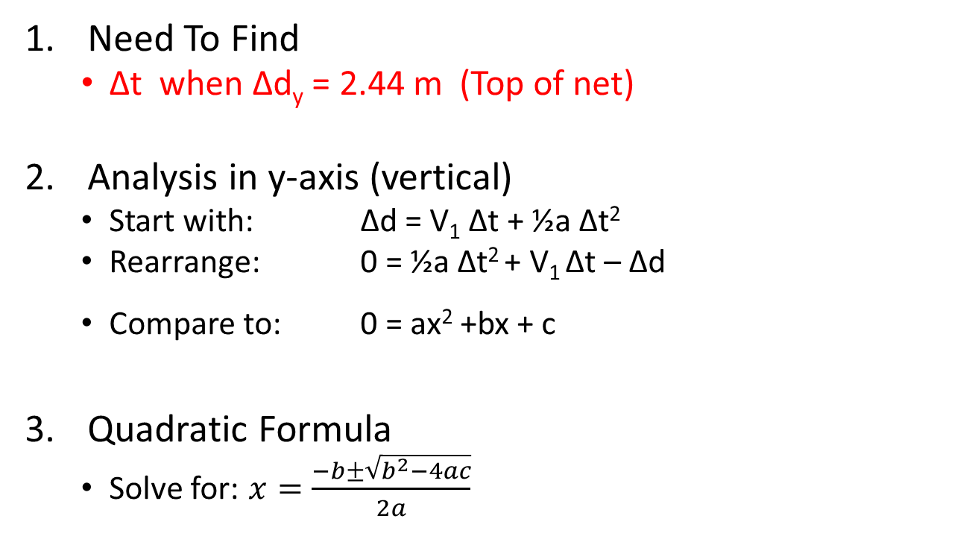
Projectile Motion Conditions #2
(Hints)
Need To Find
  Δt when Δd_{y} = 2.44 m (Top of net)
Analysis in y-axis (vertical)
  Start with: Δd = V₁ Δt + ½a Δt²
  Rearrange: 0 = ½a Δt² + V₁ Δt – Δd
  Compare to: 0 = ax² +bx + c
Quadratic Formula
  Solve for: $x=\frac{−b±\sqrt{b^{2}−4ac}}{2a}$

Slide 3
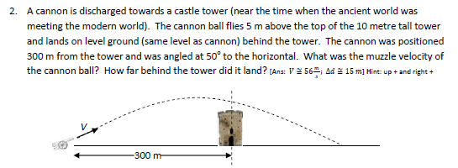
Projectile Motion – Review Problem #2
Hints:
  Unknowns are: v and Δt
  Write x-axis equation in terms of: v and Δt
  Write y-axis equation in terms of: v and Δt
  Solve POI. Two equations, two unknowns

